Slide 1
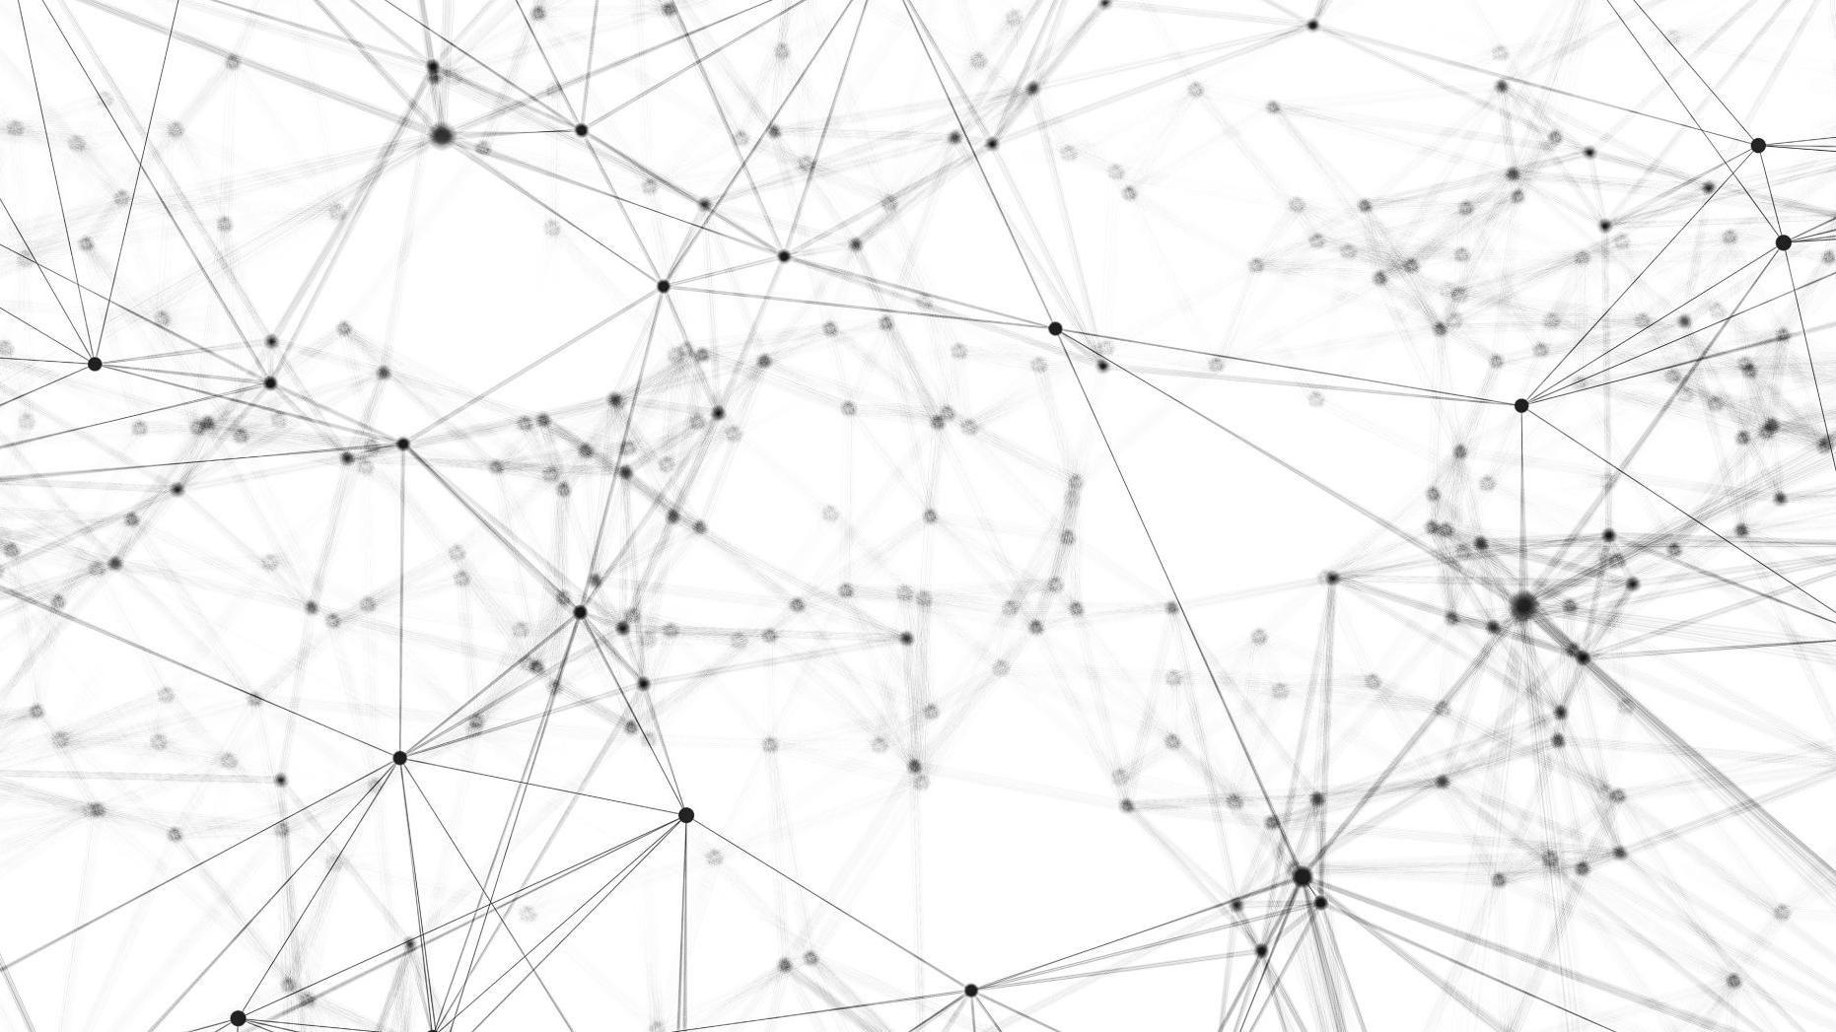
Smart city
Jae-Min Park Seung-Chan Lee

Slide 2
Smart City
A Smart city is an urban area that uses different types of IoT sensors to collect data and then use insights gained from that data to manage assets, resources and services efficiently.
Data is collected from citizens, devices, and assets that is processed and analyzed to monitor and manage traffic and transportation systems, power plants, utilities, information systems, and other community services.
Source: Wikipedia,Smart city

Slide 3
Major Smart City Technologies
These initiatives are supported by smart technologies, such as the IoT and ICT that provide the technical framework to implement smart city projects.
Source: HereMobility,Smart city

Slide 4
IoT
IoT is an essential technology without which smart city initiatives cannot exist. IoT sensors collect the data that enables the technology solutions to be effective. For example, smart water meters reporting water quality and usage, alerting the water company of leaks, or potential contamination.

Slide 5
ICT
Smart city initiatives need big data analytics to function. Huge datasets must be analyzed and processed to implement smart city services. Big data platforms have to sort, analyze and process the data gathered from the IoT.
City governance integrates ICT solutions to interconnect public services, at the same time engaging communities in local governance, thus promoting cooperation.

Slide 6
Big data for smart city transportation
A smart transport infrastructure uses big data to provide residents with access to faster and safer travel across the city. At the same time, it gives city authorities data about traffic flow allowing them to manage the transit efficiently.

Slide 7
Big data for smart city infrastructure
Smart cities share one characteristic, all use sensor data to improve city management. Big data can help cities to monitor and manage urban issues such as waste disposal, transportation, and saving resources. To do that, the city needs to install sensors in the infrastructure, retrofitting or replacing outdated infrastructure when necessary.

Slide 8
To transform a city infrastructure in “smart”, the city manager should develop three layers of “smartness” as follows:
The tech base include networks of sensors and connected devices who gather data
The second layer consists of the deployment of smart applications that process the raw data, translating it into alerts, insight, and actions.
The third layer involves widely adopting the system by the residents.

Slide 9
Benefits Of Smart City Solutions
According to this Mckinsey Global Institute report, for a city to be smart, it should use technology and data with the purpose of delivering a better quality of life. most city residents agree that a good quality of life should include improvement in the following areas:
Public safety, Faster commutes, Economic prosperity, Greener environment

Slide 10
Conclusion
Smart city technologies and applications help cities to change into a greener, safer and effectively planned urban environment. It is no surprise then, that the smart city model is proving successful with over 50 smart cities around the world using smart technologies to improve the quality of life of its residents.
With more planned smart cities sprouting from America to Asia, the technologies that form the basis of the model will continue to evolve, with the technology industry developing newer applications and solutions for building the cities of the future.

Slide 11

THANK YOU

